Slide 1
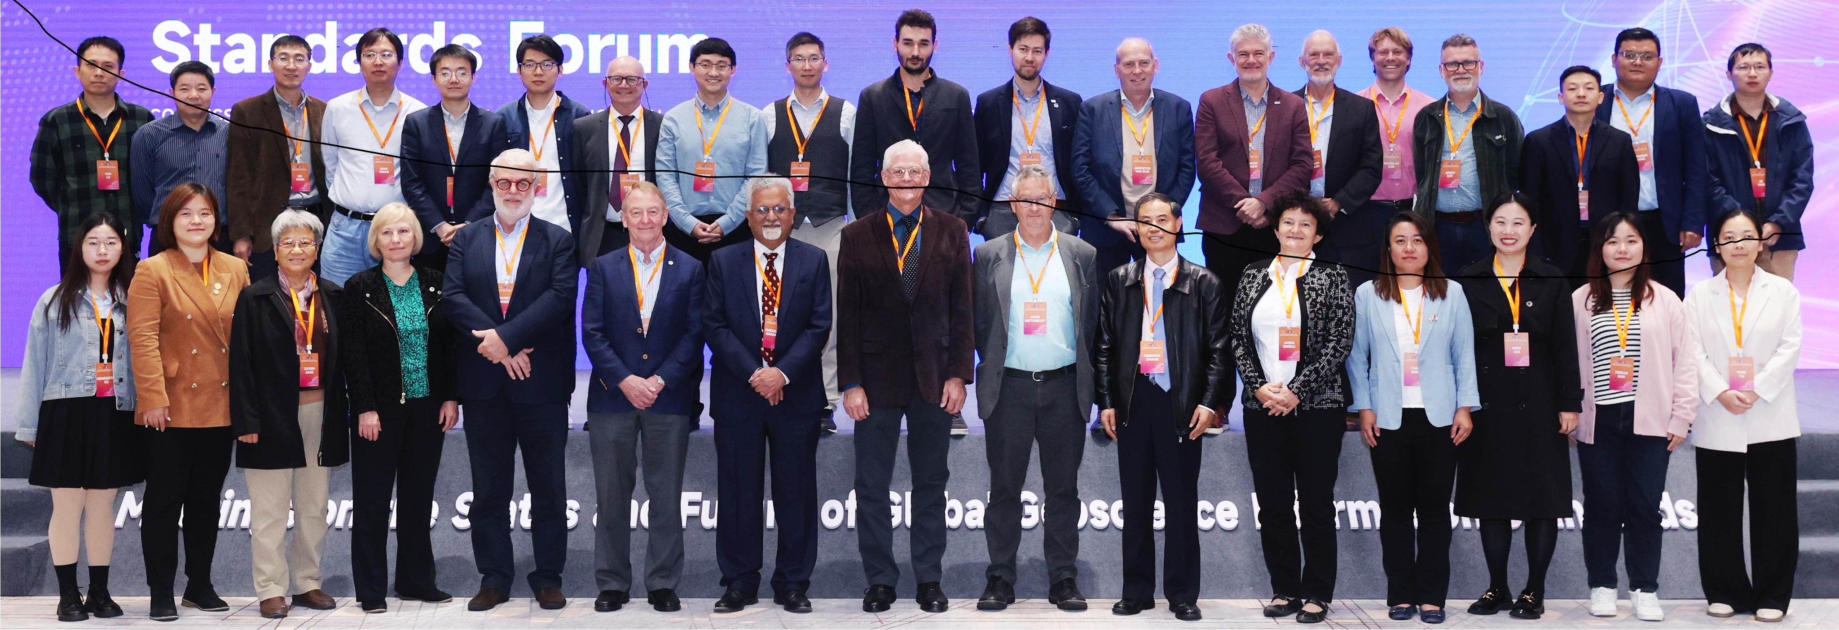
Geoscience information metadata standard supports DDE resources Open and FAIR
Zhang Minghua, Stephen Richard, Yu Hailong, Liu Rongmei, Jiang Zuoqin, Edd Lewis, Tim Duffy, Federica Foglini, Caterina Bergami, Fan Junxuan, Hu Xiumian, Wang Juanle, Zhu Yunqiang, Marshall Ma, Ma Chao, Hu Linshu, Ren Wei, Linshu Hu
Aug.30 , 2024

Slide 2
outline
Motivation
Metadata specification
Catalog implementation
Harvesting
How to participate

Slide 3
Motivation
Facilitate utilization of geoscience information to address challenges facing society
Approach
Develop specification for standardized metadata
Deploy catalog software (Geonetwork-OpenSource)
Harvest metadata from project partners
Outreach, continuous improvement

Slide 4
Metadata specification
Base on ISO19115-3
Simplify XML encoding
Extend vocabularies

Slide 5
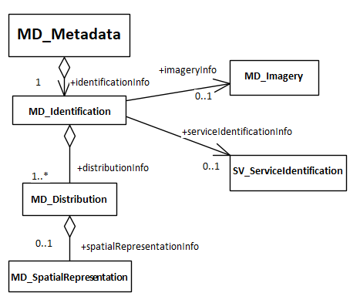
Metadata framework
Record container
Resource description
How to get the resource
Spatial data details

Slide 6
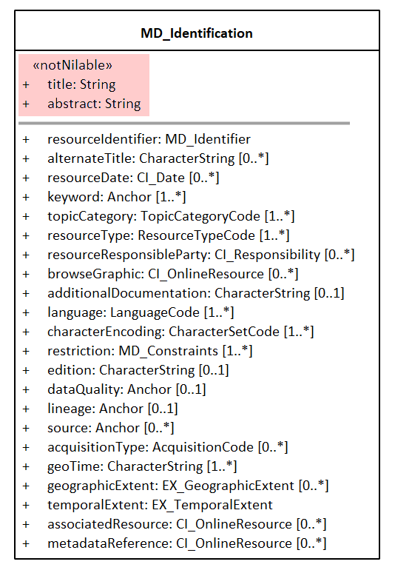
Resource description
Essential
Title
Abstract
Distribtion
8 required (nilable)
14 optional

Slide 7
Resource description
Title, abstract
Categories
  Topic
  Acquisition type
  Resource type
Keyword
Author/ responsible party
Publication date(s)

Slide 8
Resource description 2
Restrictions on access/use
Data Quality statement
Lineage statement
Sources
Geographic extent
Temporal extent
Related resource

Slide 9
Simplified XML
<identificationInfo>
<resourceIdentifier>
<authority>
<name>DataCite</name>
<role>resourceProvider</role>
</authority>
<code>https://doi.org/23609/53w7klh</code>
</resourceIdentifier>
<title>US-AZ_AZGS_1M_Lithostratigraphy</title>
<alternateTitle>Arizona 1:1000000 Lithostratigraphic map</alternateTitle>
<resourceDate>
<date>2006-05-04</date>
<dateType>publication</dateType>
</resourceDate>
<abstract>Lithostratigraphic unit distribution for …...</abstract>
<keyword>geographicarea@United States</keyword>
<keyword href="https://natlmap.gov/apps/gazrecord/1779777">Arizona</keyword>
<keyword>Geology</keyword>

Slide 10
Catalog application
  Geonetwork opensource https://geonetwork-opensource.org/
    Open Source Geospatial Foundation (OSGeo, http://www.osgeo.org) software stack
    Active developer community since 2001.
    Lots of functionality,
    Complex code base– Java, XSLT, Javascript, Angular…

Slide 11
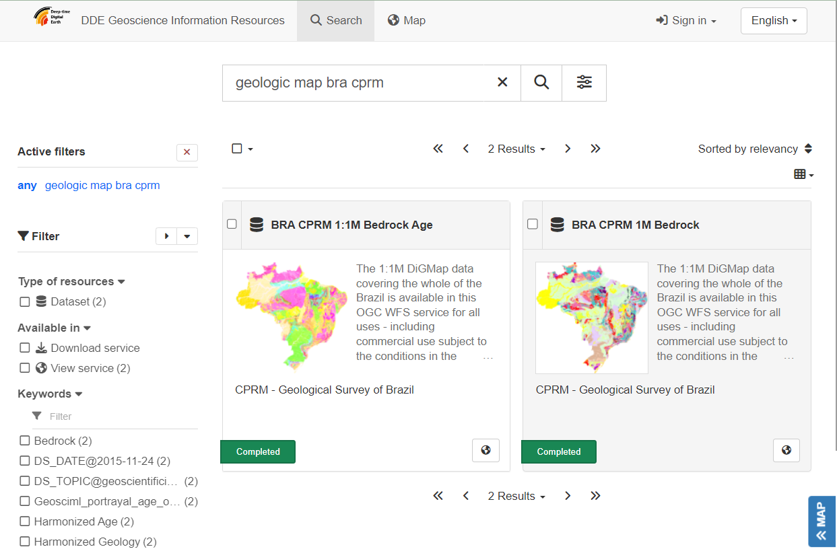
Catalog application

Slide 12
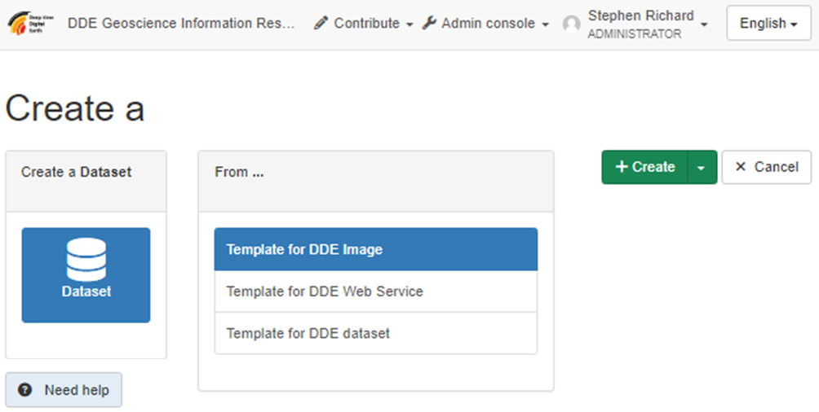
Add new metadata record

Slide 13
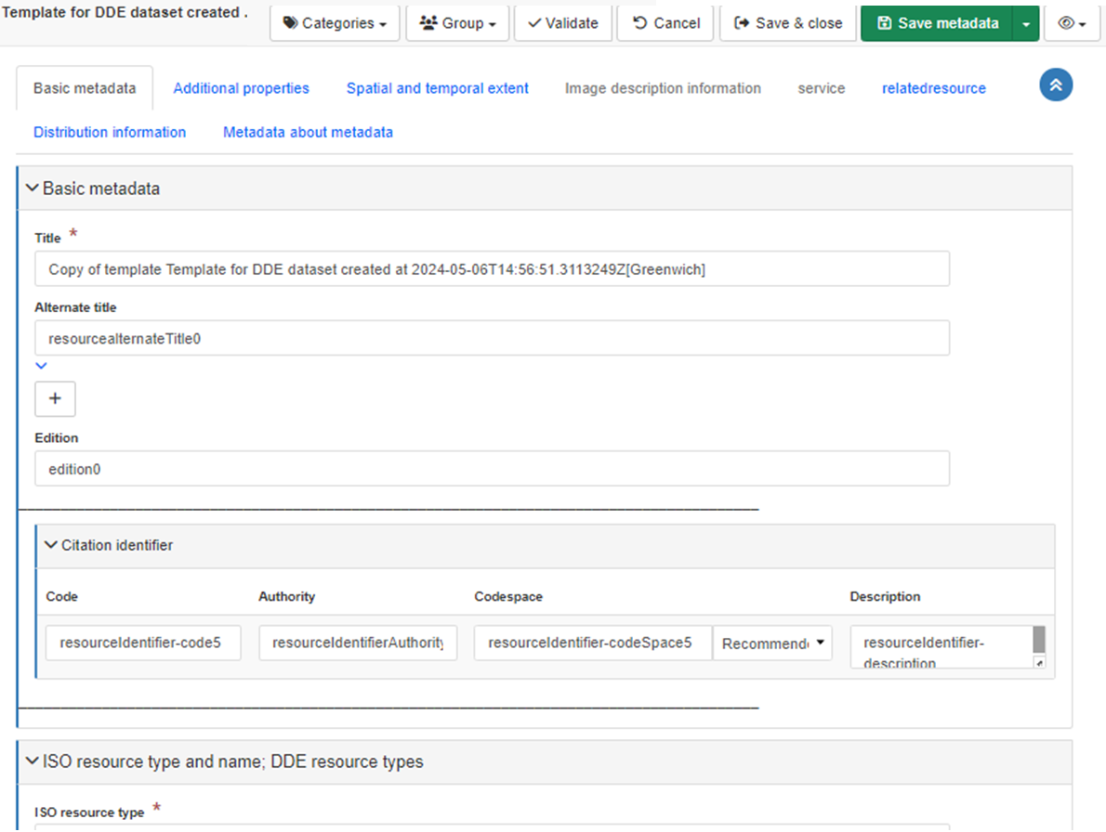
Form based editor

Slide 14
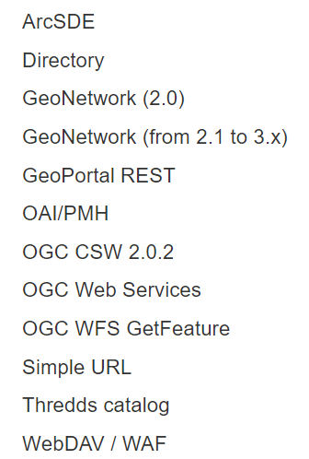
Metadata harvest
Formats:
  DDE XML
  ISO19115-3 XML
  ISO19139 XML
Protocols:
  Local directory
  OGC Catalog Service (CSW)
  Simple URL

Slide 15
Internal Details
Harvested metadata converted to 19115-3
Download as ISO19115-3 or DDE XML
Edit interface XML configuration
HTML display based on templates and XSLT
All interface labels can all be language localized

Slide 16
Your metadata ….
Get into one of the DDE harvest format:
  ISO19139, ISO19115-3, Or DDE XML
Verify DDE content
Make the metadata web accessible:
  OGC CSW
  OAI-PMH
  Web accessible folder

Slide 17
Future considerations….
Metadata requires maintenance
  Data distribution changes
  Web locations change
  Data are updated
Catalog requires maintenance
  Server updates
  Security issues
  UI improvements

Slide 18
Discovery landscape evolution….
XML → JSON/JSON-LD
Schema.org, DCAT
Opengeospatial consortium CSW → OGC API
Commercial Search Engines
World FAIR Cross Domain Interoperability Framework (https://cross-domain-interoperability-framework.github.io/cdifbook )
Ocean InfoHub (https://oceaninfohub.org/)
European data https://data.europa.eu
US Data.gov https://data.gov/
Australian Research Data Commons (https://ardc.edu.au/ )

Slide 19
Take Away
  Quality metadata content is THE challenge

Slide 20
DDE provides path for standardized, good quality metadata
Contact us to get your metadata harvested
thank you
  smrTucson@gmail.com
  Gitlab: https://opencode.deep-time.org/dde/dde-medata
Stephen M. Richard
Minghua Zhang
Linshu Hu

